Slide 1
Mental Health Concerns in Parents of Children with Autism Spectrum Disorder
Da-Yea Song¹, Jinju Jung², Guiyoung Bong², Jae Hyun Han², Hee Jeong Yoo^{1,2}
1) Seoul National University College of Medicine, Seoul, South Korea
2) Seoul National University Bundang Hospital, Seongnam, South Korea

Slide 2



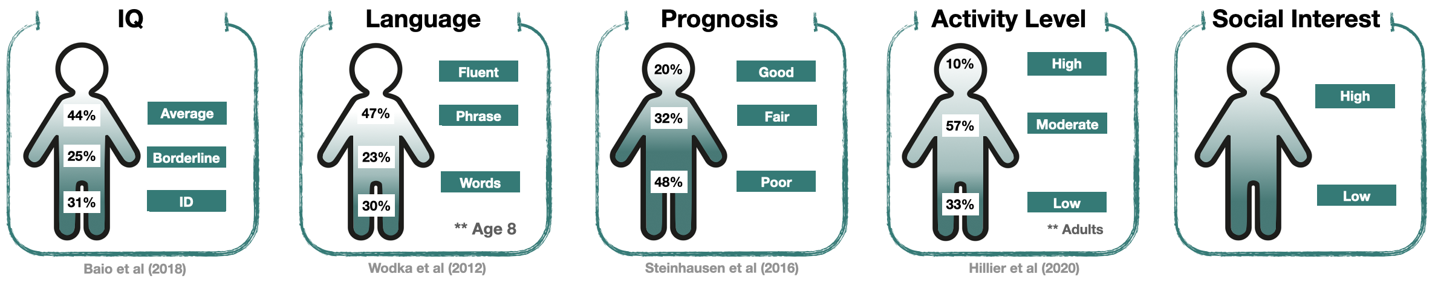
Background
Autism Spectrum Disorder (ASD) is a lifelong neurodevelopmental disorder
Social communication and interactions
Restricted and repetitive behaviors and/or interests (RRB)
ASD

Slide 3
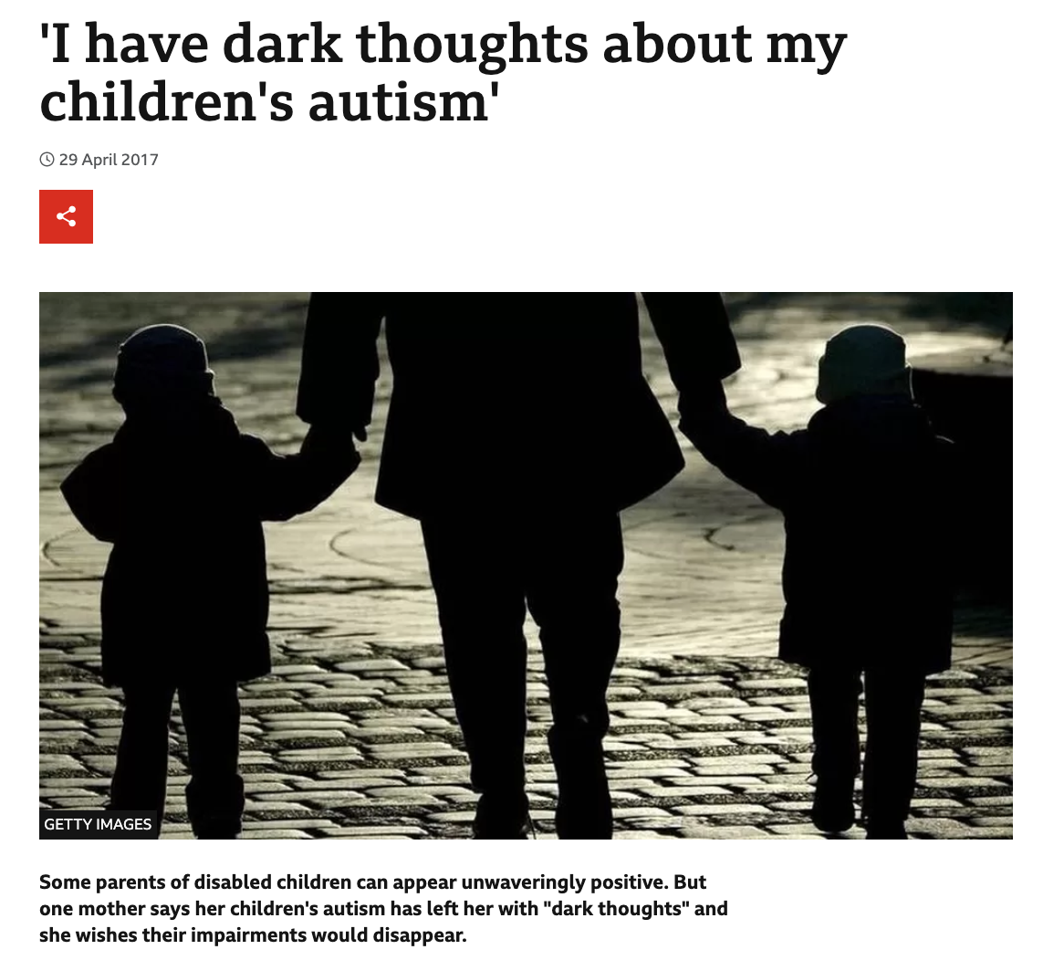
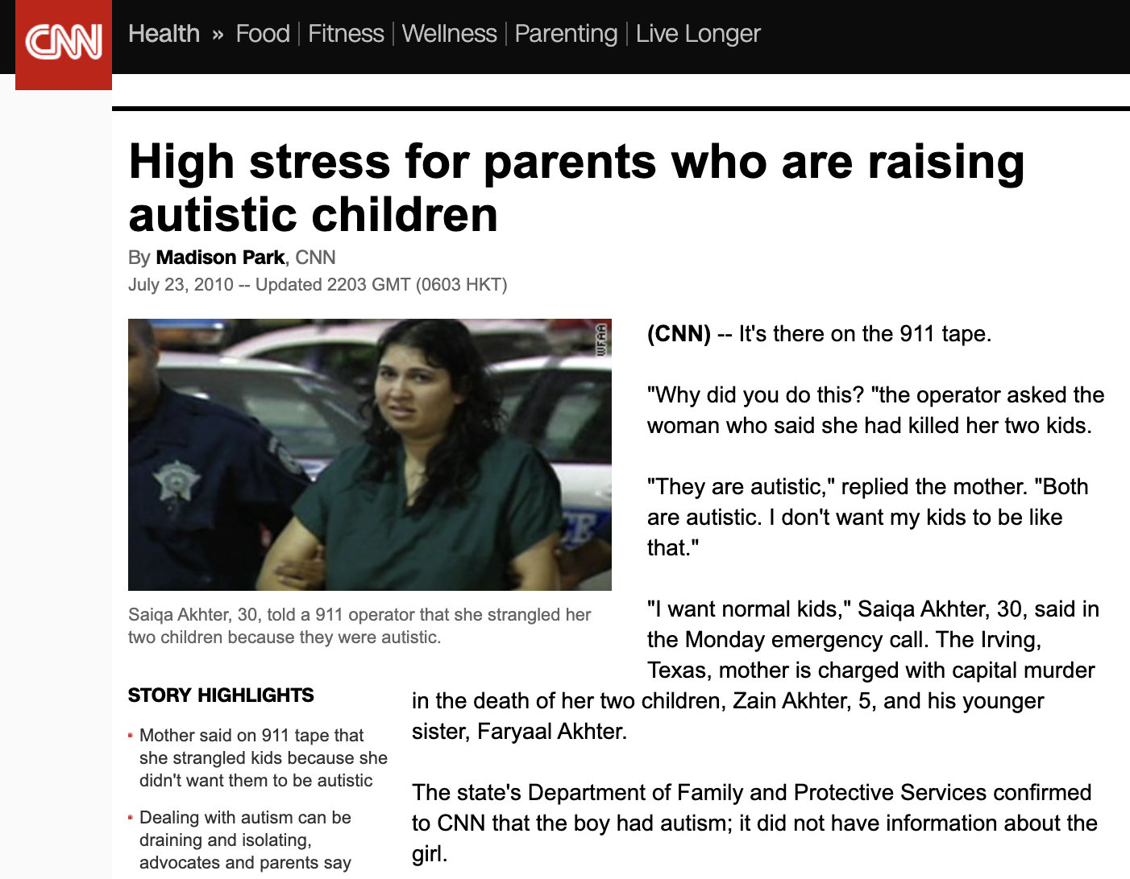
Objective

Slide 4
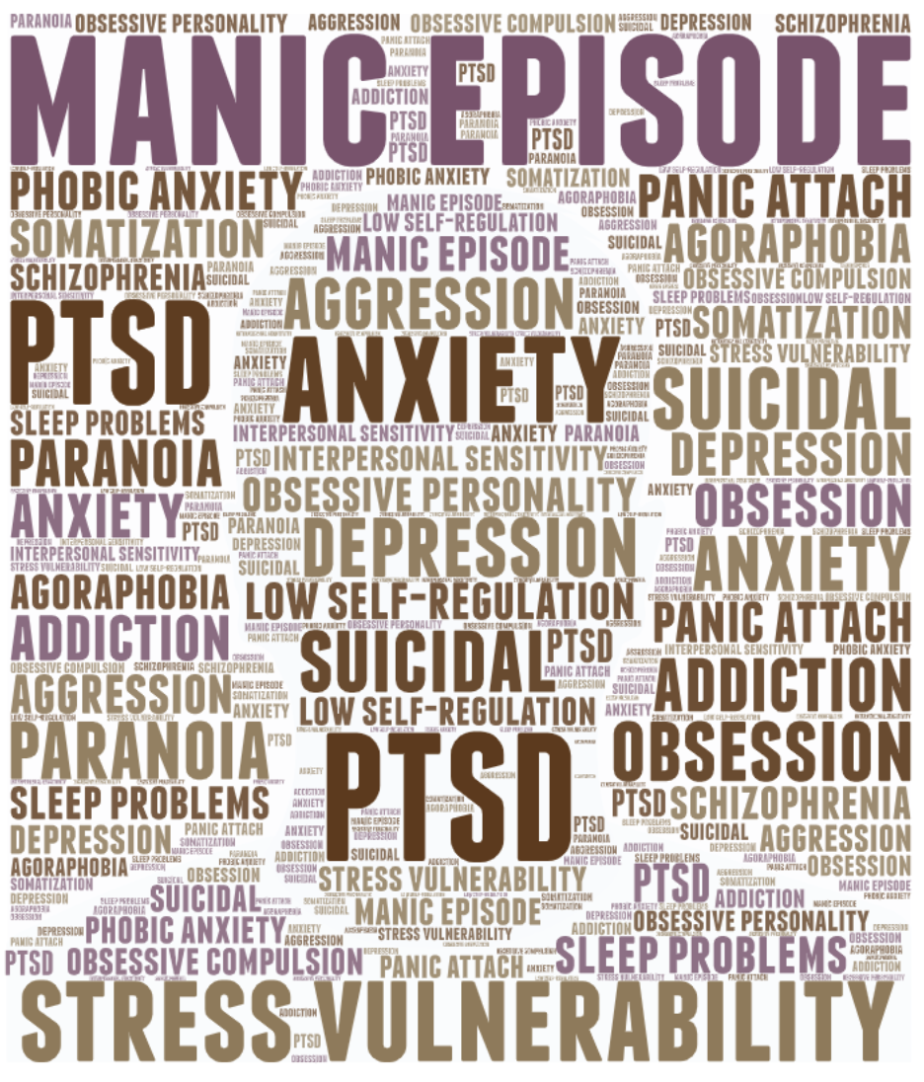
Methods
Measurements
Mental Health issues: Korean-Symptom Check List 95 (K-SCL95) T-score 60
Autistic symptoms: -Autism Diagnostic Observation Schedule -Social Responsiveness Scale -Broad Autism Phenotype Questionnaire (self/informant)
Analysis
Independent t-tests and ANCOVA

Slide 5
Results
A total of 186 parents were included for analysis
 | Mental health issue | No mental health issue | Sig
N | 120 | 66
Age | 38.9 (5.17) | 41.3 (4.3) | 0.001
Sex | 54 M 66 F | 39 M 27 F | 0.066

Slide 6
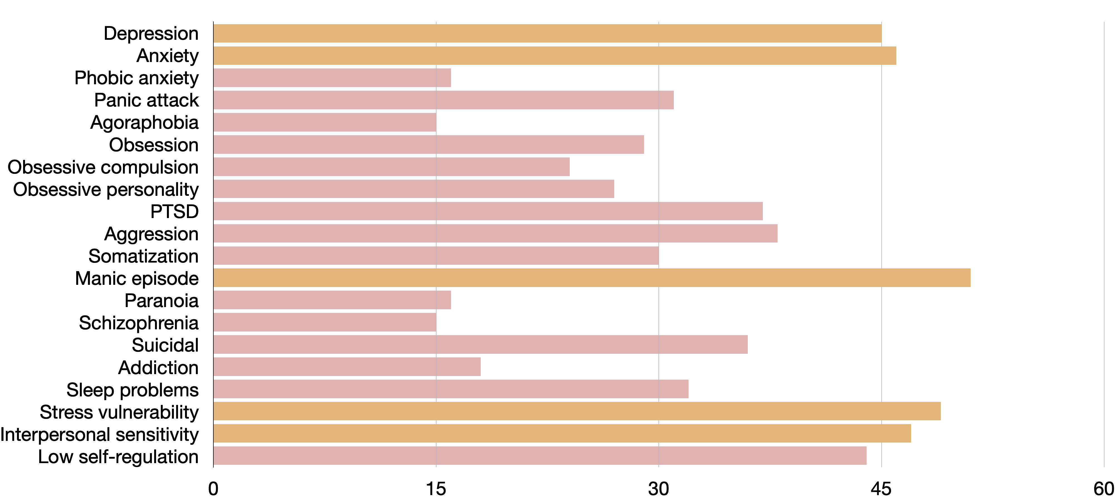
Results
Breakdown of the parents with mental health issues

Slide 7
Results
No significance between parental mental health and clinical characteristics of children with ASD
 | Mental health issue | No mental health issue | Sig
Age of child w/ASD | 5.13 (3.01) | 5.70 (3.24) | 0.236
No. of children | 1.65 (0.68) | 1.79 (0.78) | 0.211
No. of affected children | 1.11 (0.31) | 1.17 (0.38) | 0.285
ADOS Total CSS | 7.57 (1.64) | 7.28 (1.68) | 0.264
ADI-R (A/B/C/D) | 19.89 / 13.98 / 5.58 / 4.20 | 20.00 / 14.61. / 4.91 / 3.92 | 0.099~0.914
SRS T-score | 75.70 (13.45) | 75.89 (14.36) | 0.132
FSIQ | 66.32 (23.190 | 69.53 (23.80) | 0.408
VABS | 61.28 (15.91) | 62.55 (16.82) | 0.621

Slide 8
Results
Significant differences were seen between parental mental health issues and self-rated autistic symptom questionnaires
 | Mental health issue | No mental health issue | Sig
ADOS Total CSS | 1.58 (0.93) | 1.50 (0.85) | 0.863
SRS T-score | 50.43 (7.48) | 44.92 (5.08) | < 0.001
BAPQ aloof (self) | 2.91 (0.84) | 2.53 (0.81) | 0.002
BAPQ RRB (self) | 2.33 (0.82) | 2.05 (0.66) | 0.011
BAPQ PL (self) | 3.14 (0.91) | 2.63 (0.55) | < 0.001
BAPQ aloof (partner) | 2.96 (0.98) | 2.94 (1.04) | 0.936
BAPQ RRB (partner) | 2.43 (0.88) | 2.23 (0.78) | 0.137
BAPQ PL (partner) | 3.39 (0.99) | 3.03 (0.91) | 0.012

Slide 9
Conclusion
Parents of children with ASD also require support to address difficulties with mental health issues.

Slide 10
Thank you
for your attention

